Slide 1


ASQ-3 and ASQ-SE 2 Training
Sarahi Cardoza, M.Ed Disabilities Program Manager
Cell: 956-587-9382
Email: Sarahi.cardoza01@utrgv.edu

Slide 2


Head Start Performance Standards
1302.33 Child Screenings and Assessments
(A) Screening
1. In collaboration with each child’s parent and with parental consent, a program must complete or obtain a current developmental screening to identify concerns regarding a child’s developmental, behavioral, motor, language, social, cognitive, and emotional skills within the 45 calendar days of when the child first attends the program...

Slide 3
ASQ’s Timeline PY 2022-2023
*ASQ’s Due Date: September 26th – October 7th these are to be completed along with the First Parent Teacher Conference . If a child comes in after September 1st , ASQ’s will need to be completed within the same timeframe, within first 45 days that the child starts in conjunction with the First Parent Teacher Conference. Teachers must keep track of the 45-day timeline for each child.

Slide 4

Which ASQ screener is the behavioral and which one is the developmental ?
What tool/app must we use to ensure we are conducting the correct questionnaire with parent?
If the child scored (below cutoff ASQ-3) or (above cutoff ASQ-SE2) falling in 1 or more black areas, what needs to be done next?
If the child scored (close to cutoff) in 1 gray area, what needs to be done next?
If the child scored (close to cutoff) in 2 or more gray areas for ASQ-3, what needs to be done next?
If the child scored (above cutoff ASQ-3) (below cutoff ASQ-SE2) in the white area, can you still open a ASQ3 and/or ASQ-SE2 goal AND provide parent with activities?
If the child scores (above cutoff ASQ-3) (below cutoff ASQ-SE2) in the white area BUT parent has a concern in child’s behavior stated in question #9 of the summary report, what needs to be done next?
If a referral needs to be submitted, what referral forms will you submit?
If a referral needs to be done, who are you submitting the referral to?
If the ASQ results show a concern, but parent would like to wait to refer the child to ECI, does the teacher still need to submit a referral?

Slide 5

Why do we screen with ASQ-3?
ASQ-3 is a developmental screening tool designed for use by early educators and health care professionals to identify any early signs of developmental delays.
Used to detect delays early
Used to improve child outcomes
Used to encourage parent involvement and education
Because screening is recommended by major educational and medical organizations, including
  American Academy of Pediatrics
  Head Start
  Early and Periodic Screening, Diagnosis and Treatment Program (EPSDT), Medicaid’s child health program

Slide 6

Why do we screen with ASQ-SE2?
Social emotional problems in young children often go undetected.
Without support and services, social emotional problems can lead to school problems/failure, unemployment and other adult problems

Slide 7
Elements of ASQ-3: Areas & Questions
5 developmental areas (Communication, Gross Motor, Fine Motor, Problem Solving, Personal-Social)
6 questions in each area
Questions are in hierarchical order
Questions #5 and #6 are average skills for children of that age interval
  - i.e., a 12-month skill for a 12-month child, not a 16-month skill for a 12-month-old
Response options: Yes, Sometimes, Not Yet
Written at 4th- to 5th-grade reading level

Slide 8
Elements of ASQ:SE-2
Developed as a complement to the ASQ-3 questionnaire; behavioral screener to identify social emotional delays or disorders
30 questions that can be used to identify children from 1-72 months old
Available in English and Spanish
  Written at a 4th grade level
Screens for 7 domains:
  Self regulation, compliance, communication, adaptive functioning, autonomy, affect and interactions with others

Slide 9
The ASQ-3 Age Intervals
21 Questionnaire intervals:
  2, 4, 6, 8, 9, 10, 12, 14, 16, 18, 20, 22, 24 months (spaced 2 months apart)
  27, 30, 33, 36 months (spaced 3 months apart)
  42, 48, 54, 60 months (spaced 6 months apart)
  Corrected date of birth used for children born more than 3 weeks premature for up to 2 years of age
  ASQ-3 Age Calculator (www.agesandstages.com/age-calculator/) helps select correct interval

Slide 10
ASQ:SE-2 Age Intervals questionnaires
2 month questionnaire used for 1 – 3 months old child
6 month questionnaire used for 3 – 9 months old child
12 month questionnaire used for 9 – 15 months old child
18 month questionnaire used for 15 – 21 months old child
24 month questionnaire used for 21 – 27 months old child
30 month questionnaire used for 27 – 33 months old child
36 month questionnaire used for 33 – 42 months old child
48 month questionnaire used for 42 – 52 months old child
60 month questionnaire used for 54 – 72 months old child
ASQ Calculator Site- Ages and Stages (asqagecalculator.com)

Slide 11
Ages & Stages Questionnaire 3
Questionnaires may take between 10–15 minutes or longer for parents to complete with teacher.
Questionnaire MUST be completed by parent with teacher guidance
Teacher MUST review ASQ-3 to ensure all scores have been totaled correctly.
Teacher MUST review and read all responses from screener to gather more accurate information about the child. Example
Teachers must document the parent’s response as well as concerns.

Slide 12
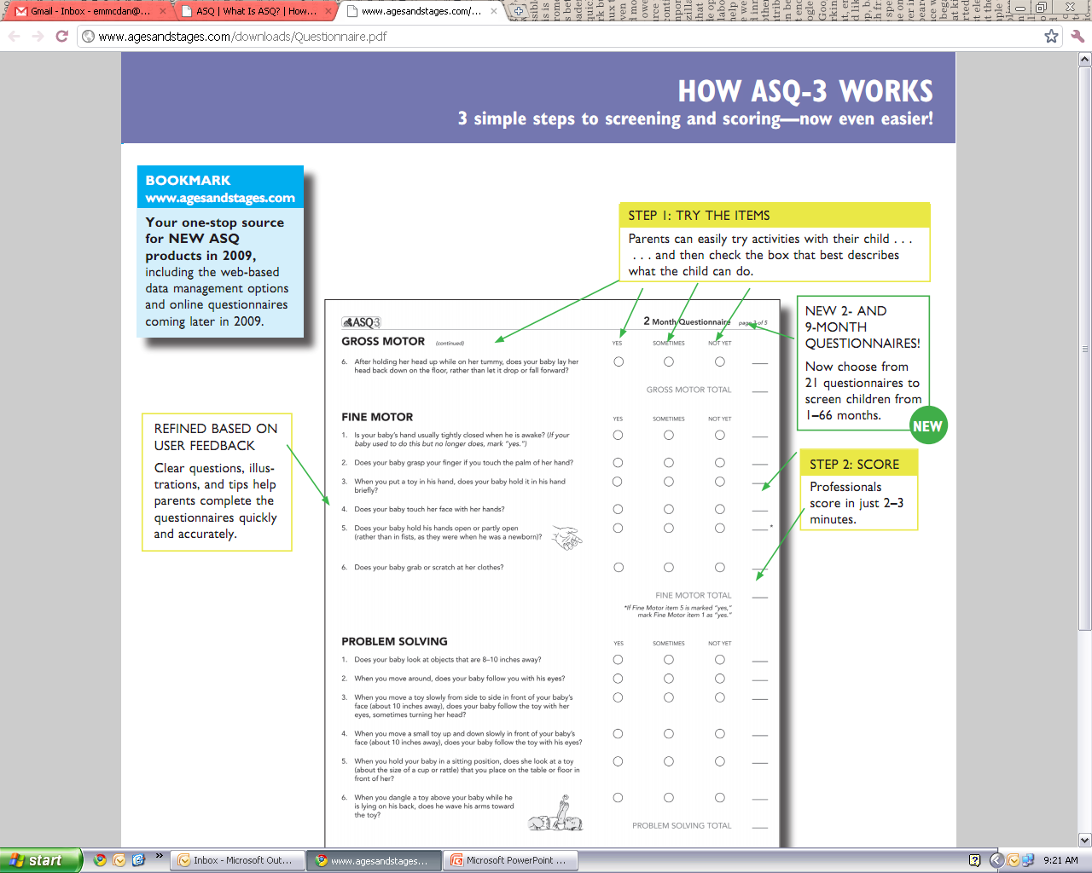
ASQ-3 Step 1: Try the items
Parents with teacher assistance complete the items of the questionnaire alone, or a professional can help guide the parent through completion if there are literacy or language learning problems
Most parents can complete a questionnaire in 10−15 minutes
Be sure the correct age interval is being used

Slide 13
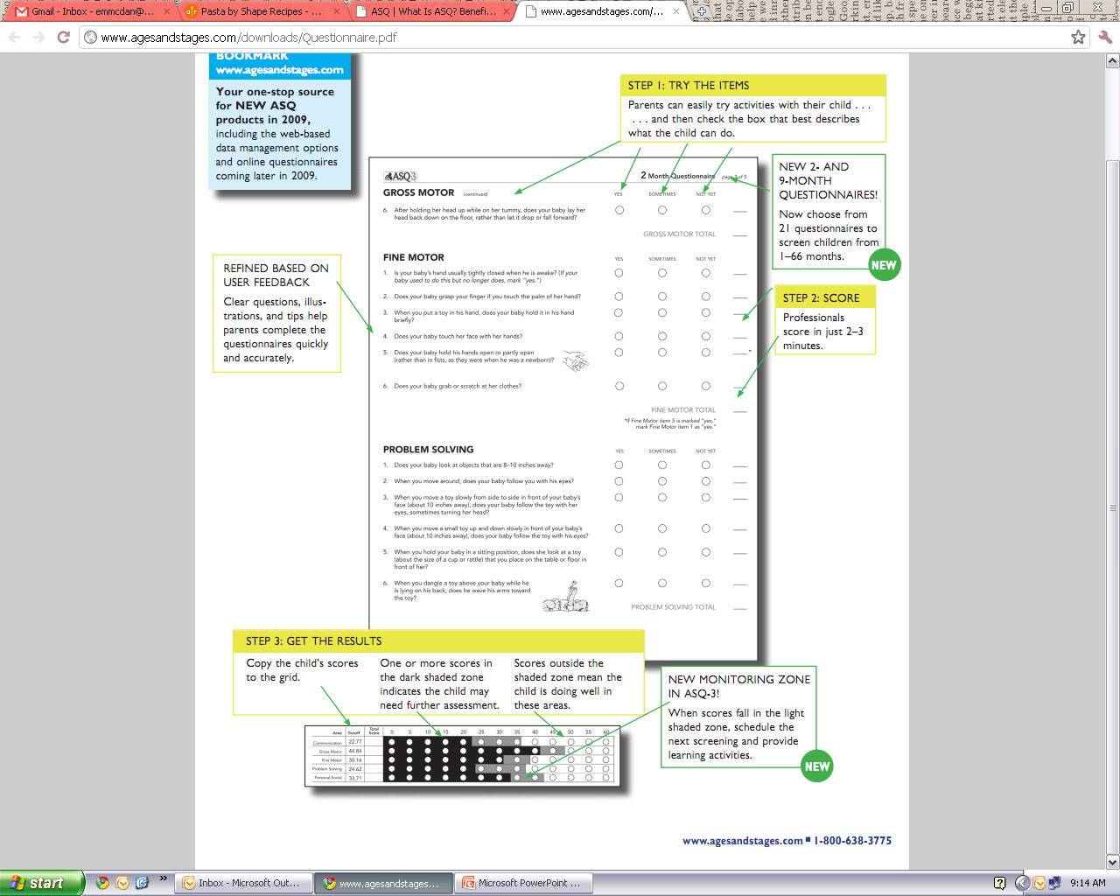

Step 2: Score the questionnaire
Professionals score the questionnaires with a simple 0, 5, and 10 point scoring system
Scores from the 5 areas are transferred to the Information Summary page
Scoring can be completed in 1−3 minutes

Slide 14

Step 3: Get the results
Review child’s scores and compare to standardized cutoffs on
Information Summary page
Interpret results
Determine follow-up actions, if needed
Monitor is a borderline screen which should be monitored – Gray; Should be rescreened in 30-45 days.
Refer if in the black area. Send referral to the designated specialist (Disabilities Manager). Rescreen in 30 – 45 days.

Slide 15
Administering the ASQ:SE-2
1. Have the parent with teacher support complete the questionnaire – provide reading or translation assistance as needed
  Each questionnaire has ~30 simple worded questions and a few open-ended questions 1-5 questions
  Parents will answer “often or always” “sometimes” or “rarely or never”
2. Score the questionnaire
  Use simple scoring key, then add up the items to create total score
  Compare total score to the cutoff score on Information Summary page to determine risk level.
3. Share the results with parents
  Scores falling above empirically-derived cutoff points mean the child should be referred for further assessment

Slide 16
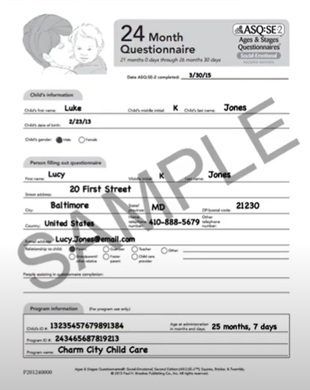
ASQ-SE2 Step 1: Have the parent with teacher support complete the questionnaire
Check for comfort with language and provide reading/interpretation assistance, as necessary.
The ASQ:SE-2 questionnaire usually takes 10-15 minutes
Be sure the correct age interval questionnaire is being used

Slide 17
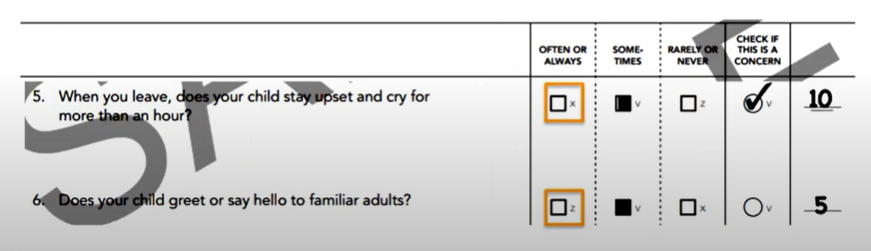
Step 2: Score the Questionnaire
Each response is coded as:
  X = 10 points, v = 5, z = 0
Items of concern are marked and indicate 5 points
Be sure to double check scoring as letters can be reversed from the above item

Slide 18
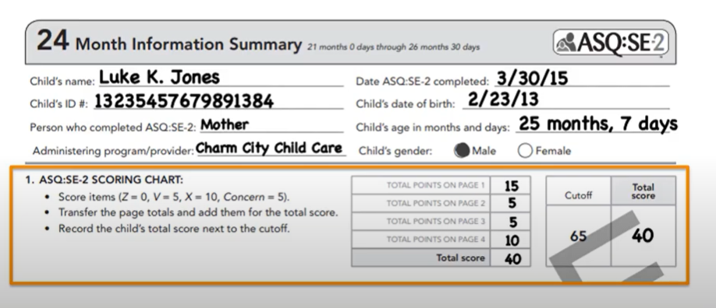
Step 2 continued
Add up the scores at the bottom of each page.
Go to the Information Summary page and add up the sum scores to create a total score

Slide 19
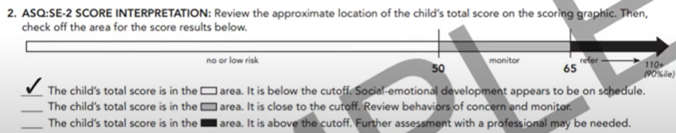
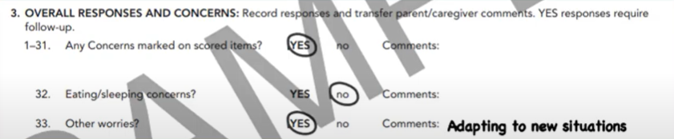
Step 2 continued
Compare total score to the cutoff points on the Information Summary page to determine level of risk
  No or low risk - White
  Monitor - Gray
  Refer - Black
Scoring can take anywhere from 1-5 minutes

Slide 20
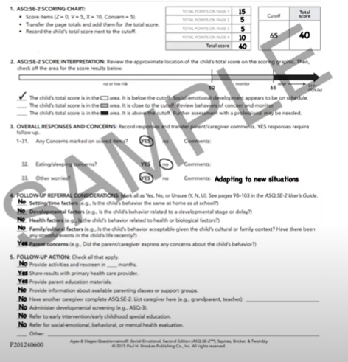
Step 3: Share the Results with parents
Interpret and discuss result findings with parent
Determine follow-up actions, if needed.
Make sure parents know that a screen that requires a referral is not the same thing as a diagnosis!!!
Low risk is a negative screen - White
Monitor is a borderline screen which should be monitored – Gray; Should be rescreened in 30-45 days.
Refer if in the black area. Send referral to the designated specialist (Disabilities Manager). Rescreen in 30 – 45 days.
As needed resources need to be provided to families for issues or concerns.

Slide 21
Reminders
1. ASQ-3 AND ASQ-SE 2 MUST BE COMPLETED Within 45 calendar days of when the child first attends the program/ Teacher is responsible for tracking the 45-day deadline.
2. Legal guardian answers ASQ’s via conference with teacher
3. Teacher reviews ASQ’s. Any questions and/or concerns with the completion of the ASQ’s will be discussed and clarified during parent teacher conference.
4.Teacher reviews before uploading and inputting into ChildPlus for center managers/site directors/ mentor coaches and disability program manager to review
After teacher revises the ASQ-3 and ASQ-SE 2 PROCEED to do the following:
5. If child scores in one monitor area (gray) ASQ-3 or grey area (ASQ-SE 2), teacher will note down on the documentation notes sheet for keepsake and provide activities using the ASQ-3 or ASQ-SE 2 strategies and open Individualization goals based on scores.

Slide 22
Reminders Continue…
6. If child scores in (two or more gray areas ASQ-3) teacher will note and complete an in-house referral form and submit to center manager/site director and Disabilities Program Manager via email. Provide activities using the ASQ-3.
7. If Child scores in area of concern (black) in ASQ-3 and/or ASQ-SE2 (65 or above) or there is a parent concern, teacher will note and complete an in-house referral form and submit to center manager/site director and Disabilities Program Manager via email. Provide activities using the ASQ-3 or ASQ-SE 2 strategies and open individualized goals based on scores.

Slide 23
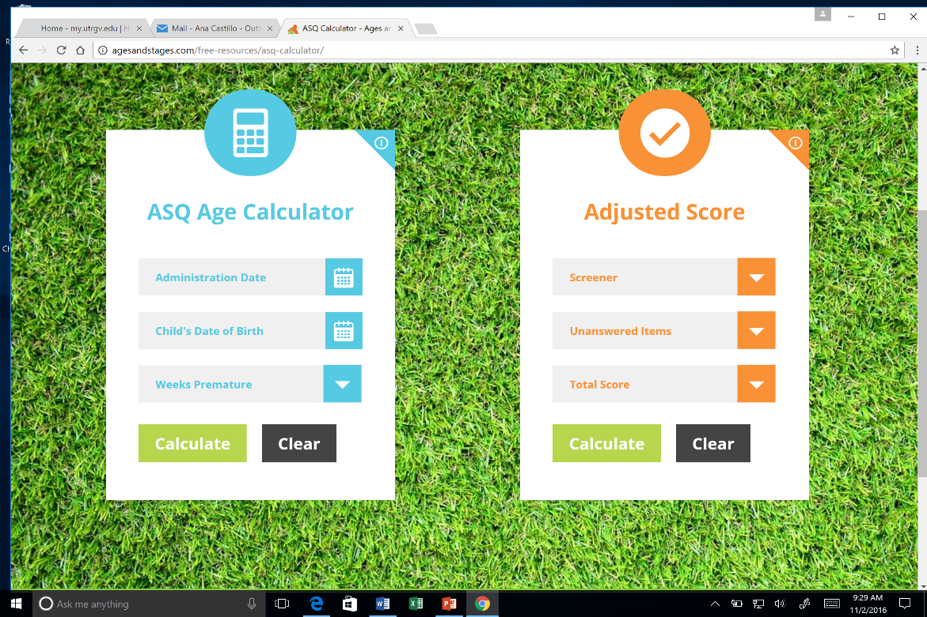
MUST DO’S
Use ASQ Calculator: http://agesandstages.com/free-resources/asq-calculator/
Complete the entire questionnaire out which means:
No blanks
Must transfer ALL answers/ responses into the Summary Report
Summary report must be filled out completely.
Follow through with the “Follow Up Action Taken” section on Summary Report.
If you are providing strategies, you MUST follow through and open a goal on your Child Development Plan.
*ASK parent if child was born premature (upon scheduling Home Visits)
*If yes, child’s age will need to be adjusted using ASQ calculator.

Slide 24
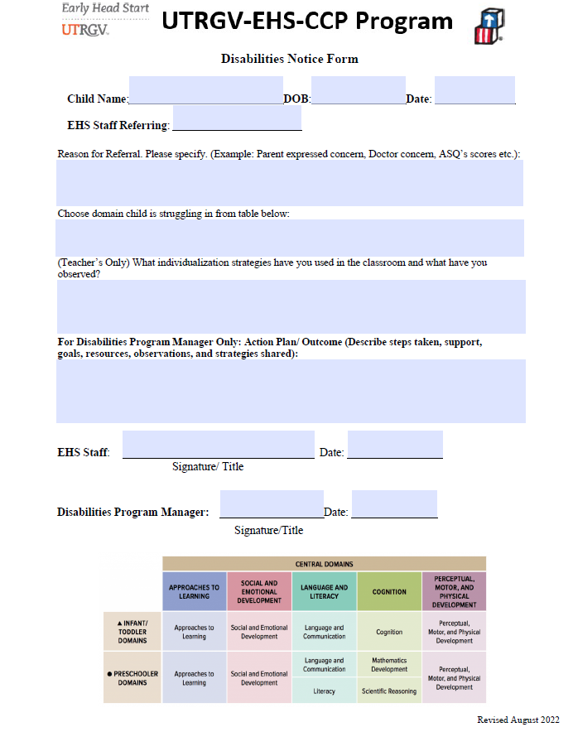
Fill out Disabilities Notice Form
To: Sarahi Cardoza: sarahi.cardoza01@utrgv.edu
CC:
Center Director/Manager

Slide 25
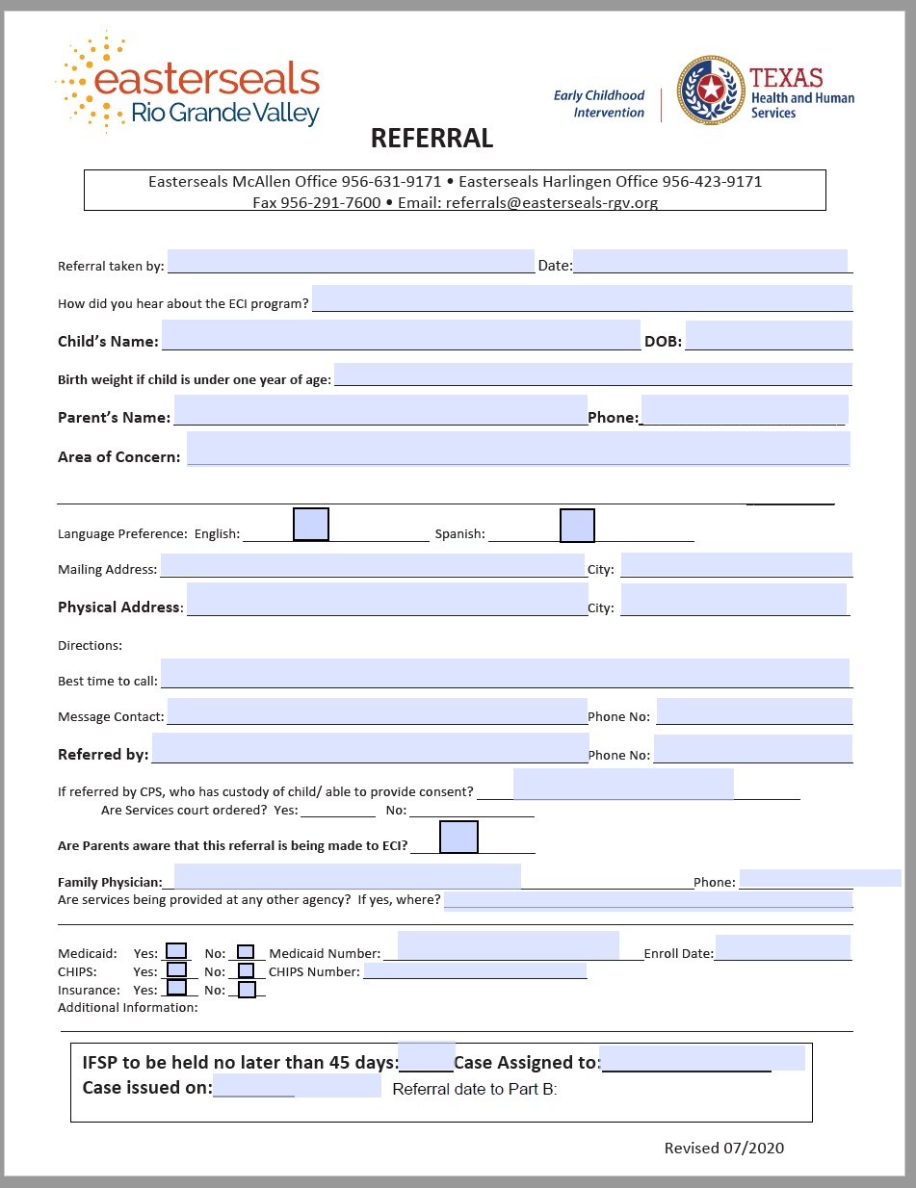
ECI Referral Forms

Slide 26
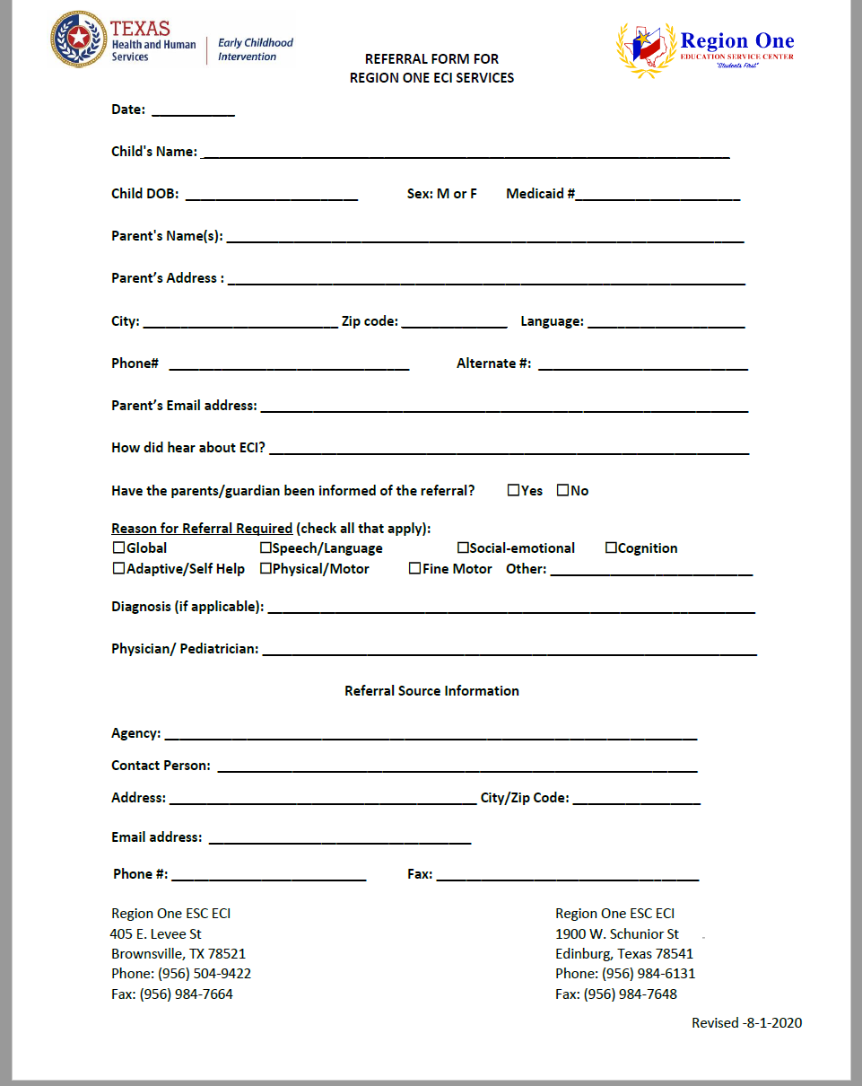


Slide 27
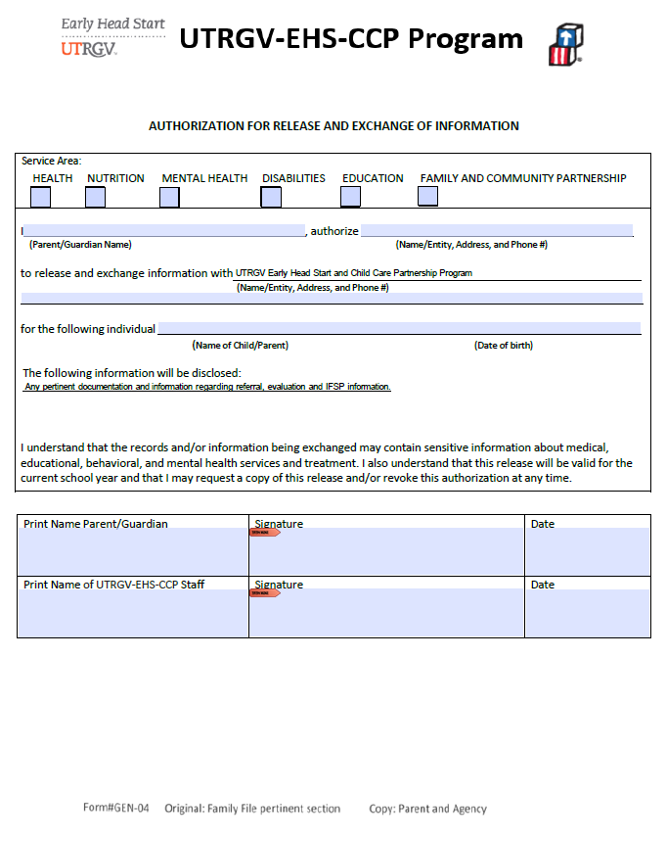
Required: Release

Slide 28
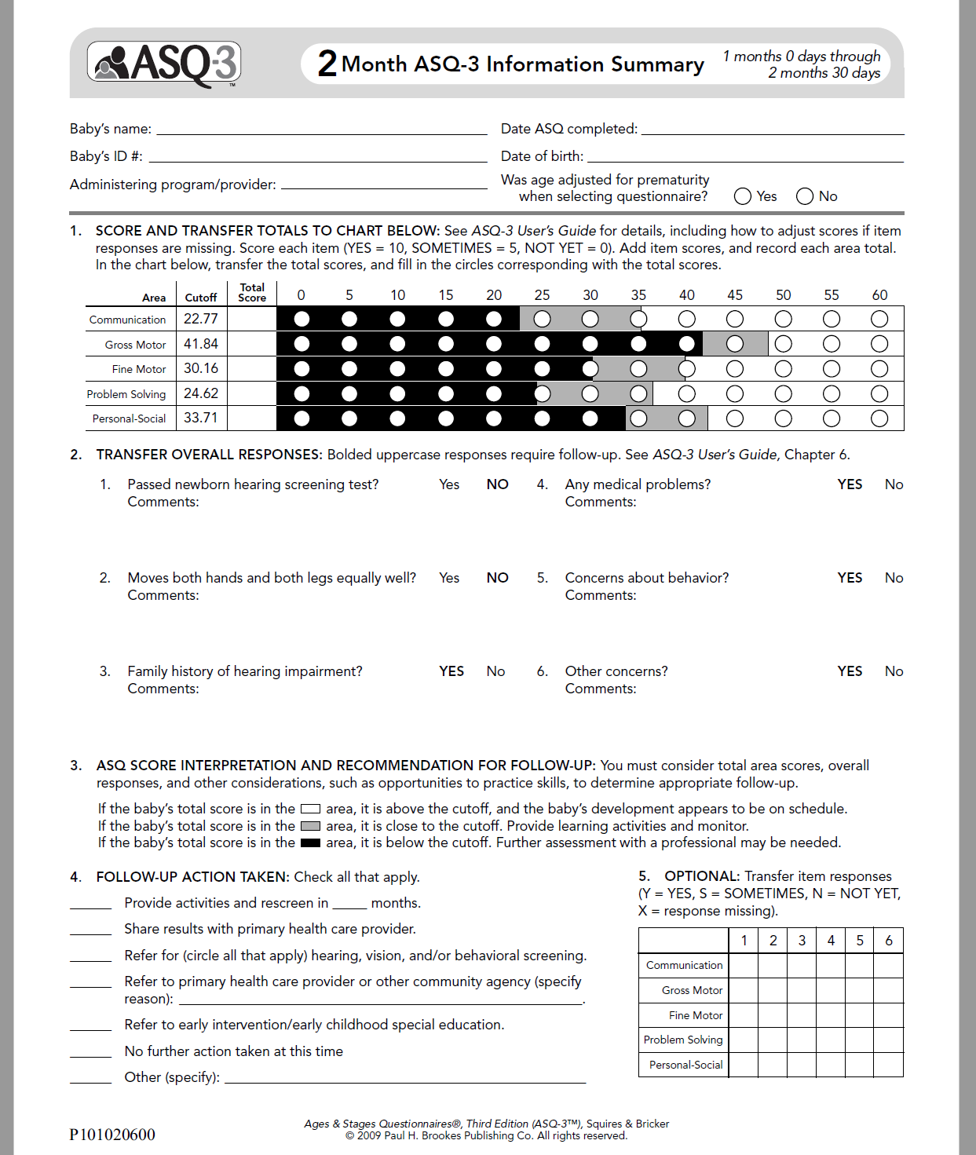
Fill out ENTIRELY THE Information Summary Report
TOP SECTION
Child’s name/ Baby ID = Child Plus ID
Date of ASQ? Day parents completes
Date of Birth
Administering program
Was age adjusted for prematurity ?
Section 1
Bubble in score AND write scores
Section 2
Transfer OVERALL responses #1-6
Section 3
Review the scores, overall responses and prepare for section 4
Section 4
MUST check off what is the follow up action for the results of ASQ. DO NOT LEAVE BLANK.

Slide 29
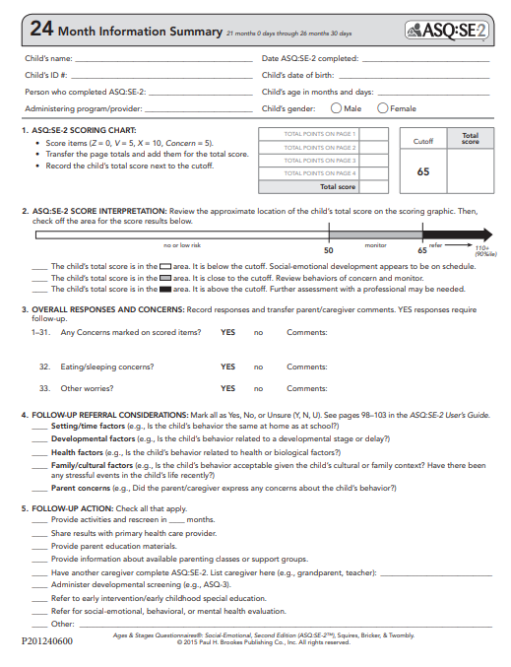
Fill out ENTIRELY THE Information Summary Report
TOP SECTION
Child’s name/ Baby ID = Child Plus ID
Date of ASQ? Day parents completes
Date of Birth
Administering program
Child gender
Section 1
Write scores
Section 2
Check off the area where the child scores
Section 3
OVERALL responses and concerns #1-30
Answer additional questions
Section 4
Label referral considerations Y (for Yes), N (for No) and U (for Unsure)
Section 5
MUST check off what is the follow up action for the results of ASQ. DO NOT LEAVE BLANK.

Slide 30
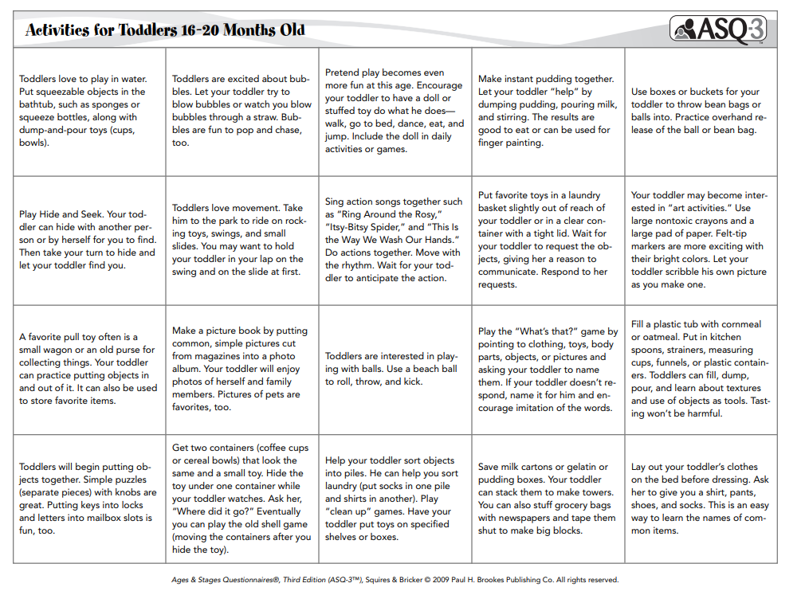
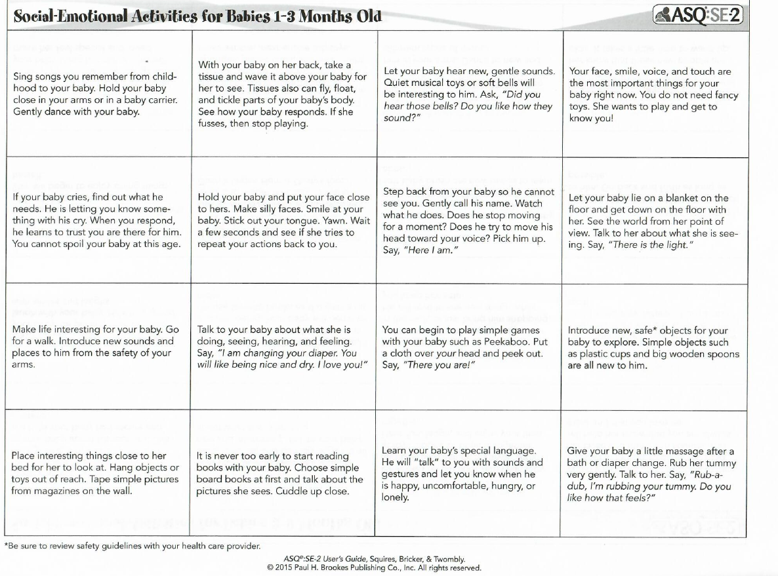
ASQ-3 and ASQ-SE 2 STRATEGIES
Goals can be opened even if child passed screener.
Use your school readiness goals to align your ASQ-3 strategies with the appropriate domain
Strategies are available in English and Spanish
ASQ3 strategies in English and Spanish will be available in the website www.ehsflexpd.com under “Education” labeled “ASQ-3 Intervention Strategy Activivities” “ASQ-SE 2 Intervention Strategy Activities”

Slide 31

Isabella Flores DOB: 2-25-2022 (Infant)
12-25-2020(Toddler)
9-25-2019 (Three-year-old)

Slide 32

Post Test
Which ASQ screener is the behavioral and which one is the developmental ?
What tool/app must we use to ensure we are conducting the correct questionnaire with parent?
If the child scored (below cutoff ASQ-3) or (above cutoff ASQ-SE2) falling in 1 or more black areas, what needs to be done next?
If the child scored (close to cutoff) in 1 gray area, what needs to be done next?
If the child scored (close to cutoff) in 2 or more gray areas for ASQ-3 and/or the gray area but closer to black area for ASQ-SE2, what needs to be done next?
If the child scored (above cutoff ASQ-3) (below cutoff ASQ-SE2) in the white area, can you still open a ASQ3 or ASQ-SE2 goal?
If the child scores (above cutoff ASQ-3) (below cutoff ASQ-SE2) in the white area BUT parent has a concern in child’s behavior stated in question #9 of the summary report, what needs to be done next?
If a referral needs to be submitted, what referral forms will you submit?
If a referral needs to be done, who are you submitting the referral to?
If the ASQ results show a concern, but parent would like to wait to refer the child to ECI, does the teacher still need to submit a referral?

Slide 33
Answers
1. ASQ-3 is the Developmental Screener and ASQ-SE2 is the Behavioral Screener
2. ASQ-3 Calculator
3. Disabilities Notice Form, Authorization to Release/Exchange Information, and Easter Seals, or Region One Referral Form should be done by teacher and provide strategies to parent. Rescreen in 45 days.
4. Provide strategies to parent, open a ASQ3 goal and monitor the child.
5. Disabilities Notice Form, Authorization to Release/Exchange Information, and Easter Seals or Region One Referral Form should be done by teacher and provide strategies to parent. Rescreen in 45 days.
6. Yes, there is always room for improvement.
7. Disabilities Notice Form, Authorization to Release/Exchange Information, and Easter Seals or Region One Referral Form should be done by teacher.
8. Disabilities Notice Form+ Authorization to Release/Exchange Information + Region One or Easter Seals Referral Form.
9. Center Manager/Site Director and Disabilities Program Manager.
10. Yes, fill out Disabilities Notice Form to inform the Disabilities Manager the parent chose to wait.

Slide 34
Resources
RGV-EHS Professional Developement (ehsflexpd.com)
Resource Library - Ages and Stages

Slide 35

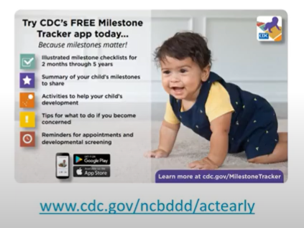
Conclusion
Regardless of the outcome, sharing screening results provides a great opportunity to promote developmental monitoring
Daily brain building activities for parents to do w/ children
CDC developed the Free milestones tracker to help parents monitor their children’s developmental milestones by providing checklists

Slide 36

Questions ?

